Slide 1
Agenda
Fall ACES Presentation
Review of Strategic Plan and priorities progress
Preparing for the Budget Development
Rank Strategic Priorities

Slide 2
Accountability
Collaboration
Equity
Support
Fall 2022 ACES Presentation

Slide 3
Notes:
Notes for the School CIP Team: This section is for Tier 3 and 4 schools. Collaborate with your district & GADOE support to outline your short-term action plan for the first 45-days of school.

Slide 13
Notes:
Notes for the School CIP Team: This section is for Tier 3 and 4 schools. Collaborate with your district & GADOE support to outline your short-term action plan for the first 45-days of school.

Slide 14
Strategic Plan Progress

Slide 15
Mission:
L.P Miles Elementary School
Vision:.
SMART GOALS
As measured by Milestones, Reading-Level 3 and up will increase from 11% to- 18% and Level 2 and up will increase from 25 % to 35%.
As measured by Milestones, Math - (Lvl 3 and up) will increase from 12% to 15% (Lvl 2 and up) will increase from 28% to 38%
Increase ADA from 90% to 92% by May 2023.
APS Strategic Priorities & Initiatives
School Strategic Priorities
School Strategies
1A Analysis of whole school MAP data quarterly & create plans based on the data.
1B. Use data analysis protocol in PLCs to consistently review current student data and inform the classroom instruction
2A. Monitor and support the implementation of the Intervention Block
2B. Lesson internalization in PLCs
3A. Implement monthly IB PLCs to train and support staff members on IB integration
3B. Facilitate IB walkthroughs, observations, and modeling to ensure integration
Fostering Academic Excellence for All
Data
Curriculum & Instruction
Signature Program
Use data to drive instruction and academic decisions.
Increase academic achievement and promote growth in ELA and Math.
Implement IB Program standards and practices with fidelity.
Building a Culture of Student Support
Whole Child & Intervention
Personalized Learning
4. Increase student attendance and engagement
5. Implement a whole child support system to meet the individual needs of every student, supports social emotional learning, and promotes wellness
6. Utilize flexible learning tools, technology, and targeted instruction to personalize learning for all students
4A. CARE Team will monitor students with less than 80% ADA, excluding excused absences, through Individualized Success Plan
4B. CARE Team and identified staff will make weekly outreach calls for all students with less than 80% ADA
4C. Offer opportunities for students to be engaged in clubs, extra-curricular activities, and extended learning experiences.
5A. Den services will be provided to match the specific needs of each student
5B. Advisory classes with integrated SEL lessons
6A. Provision of devices to create a 1:1 access, tech support, ……….
6B. Utilization of interactive technology platforms to promote personalized and adaptive student learning and create individualized student learning paths

Slide 16
Mission:
L.P. Miles Elementary School
Vision:
SMART GOALS
As measured by Milestones, Reading-Level 3 and up will increase from 11% to- 18% and Level 2 and up will increase from 25 % to 35%.
As measured by Milestones, Math - (Lvl 3 and up) will increase from 12% to 15% (Lvl 2 and up) will increase from 28% to 38%
Increase ADA from 90% to 92% by May 2023
APS Strategic Priorities & Initiatives
School Strategic Priorities
School Strategies
Equipping & Empowering Leaders & Staff
Strategic Staff Support
Equitable Resource Allocation
7. Build teacher capacity to support academic achievement
7A. Ongoing professional learning and promote opportunities for teachers to serve as leaders within the building (recruitment ambassadors, serving as instructional exemplars, etc.)
7B. Teachers will facilitate PLCs using an established protocol
Creating a System of School Support
Collective Action, Engagement & Empowerment
8. Sustain and enhance family engagement that fosters positive relationships with all stakeholders in an effort to promote academic achievement
8A. Maintain and promote an active GO Team
8B. Create opportunities for parents, local businesses, community partnerships, and other stakeholders to engage with the school on a consistent basis
8C. Create and sustain a warm culture where everyone feels valued and welcomed
8D. Maintain consistent communication with all stakeholders
8E. Establish a PTA

Slide 17
Action on the Updated Strategic Plan
The GO Team needs to TAKE ACTION (vote) on its updated Strategic Plan. After the motion and a second, the GO Team may have additional discussion. Once discussion is concluded, the GO Team will vote.

Slide 18
Preparing for Budget Development

Slide 19
Discussion
Strategic Plan Priority Ranking
In preparation for the 2023-2024 Budget Development (January–March 2023), the GO Team needs to rank its Strategic Plan Priorities. Use the next slide to capture the priority ranking.

Slide 20
Strategic Plan
Priority Ranking
Insert the school’s priorities from Higher to Lower
Higher
Use Data to drive instruction and academic decision.
Build teacher capacity to support academic achievement.
Increase academic achievement and promote growth in ELA and Math.
Increase student attendance and engagement
Sustain and enhance family engagement that fosters positive relationships with all stakeholders in an effort to promote academic achievement.
Implement IB Program standards and practices with fidelity.
Implement a whole child support system to meet the individual needs of every student, supports social emotional learning, and promotes wellness.
Utilize flexible learning tools, technology, and targeted instruction to personalize learning for all students.
Lower

Slide 21
Action on the Strategic Plan Priorities
The GO Team needs to TAKE ACTION (vote) on its ranked Strategic Plan Priorities. After the motion and a second, the GO Team may have additional discussion. Once discussion is concluded, the GO Team will vote.

Slide 22
Where we’re going
Next, we will begin the discussion of the 2023-2024 budget.
Let me or the Chair know of any additional information you need for our future discussion.

Slide 23
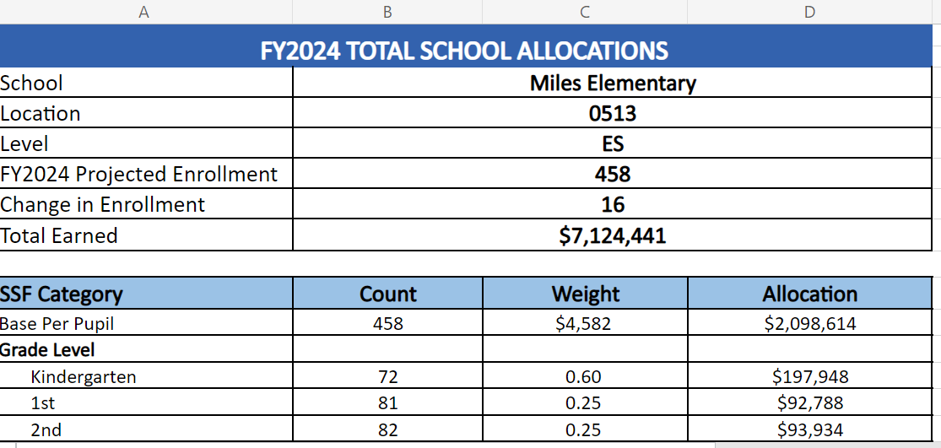
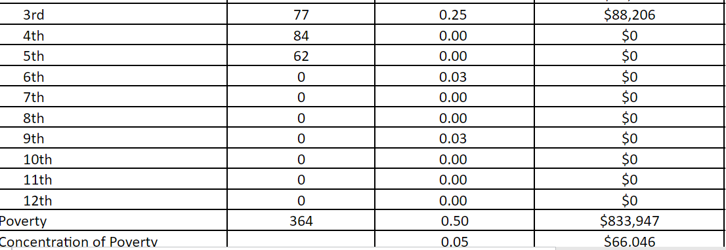

Slide 24
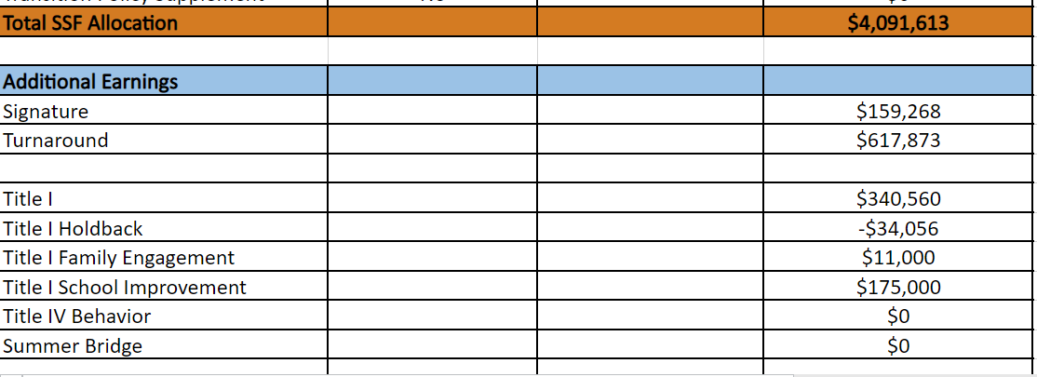

Slide 26
In addition to a General Fund allocation, our school has been allocated CARES funding that must be used to support implementation of the school-based intervention block and other school-based needs as a result of the COVID-19 Pandemic.
Once the support needed to implement our school-based intervention block/course has been fulfilled, we can use the remaining CARES funds to address other school-based needs that are a result of the COVID-19 Pandemic.

Slide 28
Thank you

